Slide 1
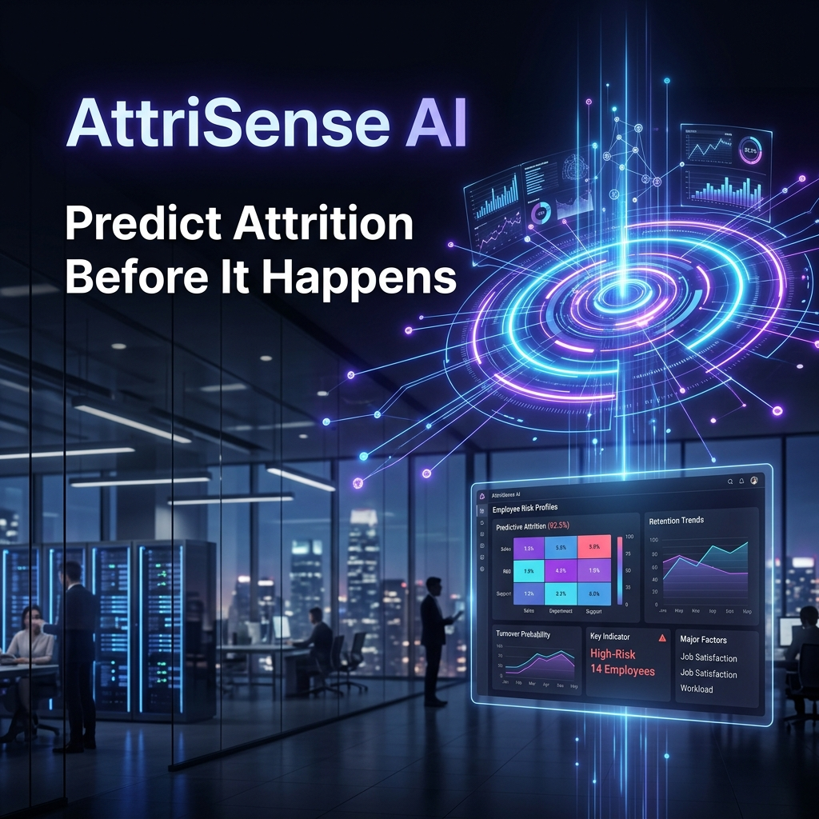
AttriSense AI
Predictive Attrition Intelligence Platform
LTTS Global Hackathon 2026 | Jury Presentation

Slide 2
The Problem & Cinematic 'Pre-Crime' Twist
Voluntary Exits Cost ₹2.5 Lakh Per Person. What if We Could Intercept Them?
📊 The Corporate Cost of Attrition
• ₹2.5 Lakh Replacement Cost: Recruitment, onboarding, lost productivity, and knowledge transfers average ₹2.5 Lakh per employee departure.
• LTTS Historical Trend: LTTS attrition has historically hovered around 13% - 18%, aligning with the IT industry average of 15% - 20%.
• The Natural Attrition Target: Organizations do not target 0% attrition. A healthy natural attrition of 8% - 12% is required to bring fresh blood and ideas.
• The Target Goal: Prevent involuntary attrition of high-performing, critical staff who leave because workplace warning flags go unnoticed.
🔮 'Pre-Crime' Attrition Interception
• Minority Report Analogy: In the movie Minority Report, pre-crime divisions catch criminals before they commit a crime. Similarly, AttriSense AI intercepts flight risks 3 to 6 months before a resignation letter is signed.
• Moneyball for Employee Retention: Just like sports analytics flags player fatigue, AttriSense flags employee burnout, salary misalignment, and manager friction to construct preventative retention playbooks.
• Multi-Agent vs. Single Agent: Traditional single-agent setups run a single prompt that dilutes context and hallucinates. AttriSense utilizes a multi-agent assembly (Signal Detection, Sentiment NLP, Scoring, and Advisor) for specialized, zero-hallucination processing.

Slide 3
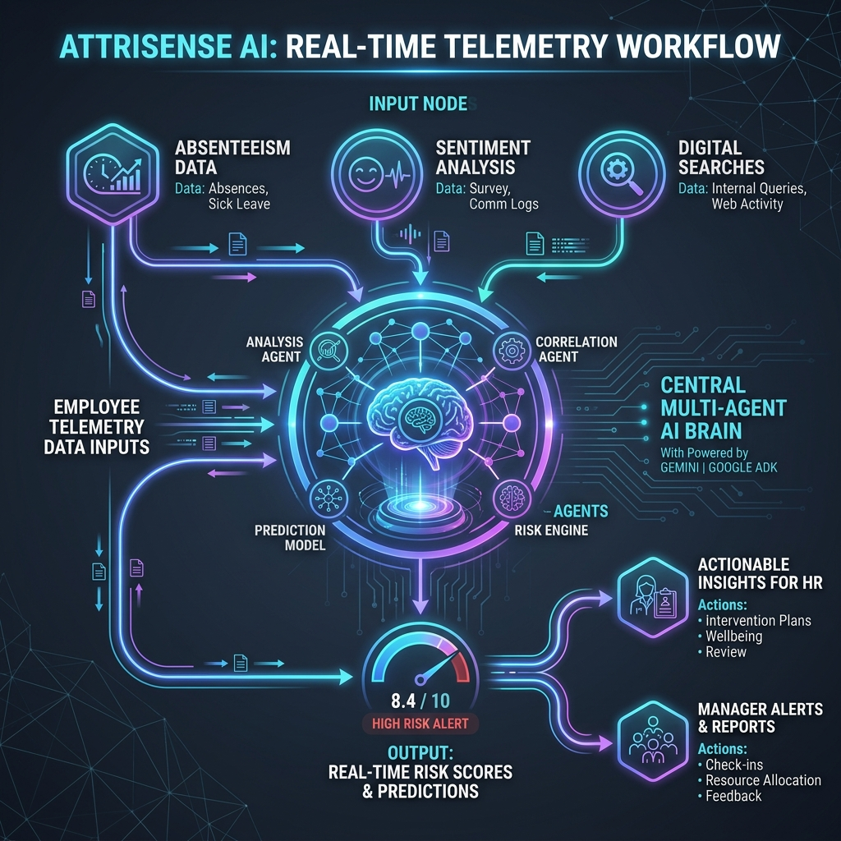
Multi-Agent System Architecture
Google ADK 2.4.0 + Specialist Agent Orchestration
📡 Step 1: Telemetry Sensor Network
Aggregates 15 continuous behavioral and work-life telemetry signals via mcp_server.
🧠 Step 2: Sentiment NLP Analyzer
Runs real-time sentiment extraction & disengagement theme detection on employee voice data.
📊 Step 3: Risk Score Calculator
Processes weights to compile a real-time risk index (0-100%) and categorizes flight risk.
💡 Step 4: AI Retention Playbook Advisor
Maps risk drivers to corporate mitigation playbooks to synthesize direct action steps.
🛡️ Step 5: Security & Privacy Gateway
Enforces PII redaction, prompt injection defense, and role-based view/edit permissions.

Slide 4
Step 1: Telemetry Sensor Network
Continuous Behavioral Sensing Across 15 Core Parameters
• Absenteeism Rate (12% Weight)
Identifies sudden increases in unscheduled leave. Warning: >10%, Critical: >15%.
• NLP Sentiment Score (10% Weight)
Quantifies employee feelings from communications/reviews. Warning: <-0.1, Critical: <-0.3.
• Performance Trend (10% Weight)
Detects drop-offs in performance ratings. Warning: Declining trend, Critical: Steep drop.
• Compensation Gap (10% Weight)
Positions salary against market rate percentile. Warning: <40th pct, Critical: <30th pct.
• Manager Scorecard (8% Weight)
Tracks manager-employee relationship scores. Warning: <6.0, Critical: <5.0.
• Promotion Gap (8% Weight)
Measures years elapsed since last promotion. Warning: >2 years, Critical: >3 years.
• Internal Job Searches (8% Weight)
Monitors internal portals for active queries. Warning: >5 searches, Critical: >8 searches.
• Meeting Participation (6% Weight)
Tracks active engagement in collaborative work/meetings.
• Collaboration Index (6% Weight)
Measures cross-team interaction levels and outgoing syncs.
• Training Activity (6% Weight)
Flags low professional development (Warning: <2 trainings/year).
• Recognition & Awards (6% Weight)
Identifies employees with zero recognition in the past year.
• Location Mismatch (5% Weight)
Flags fresher relocations to mismatched locations (High attrition risk).
• Cross-Functional Work (3% Weight)
Measures exposure to projects outside immediate teams.
• Team Social Engagement (2% Weight)
Tracks participation in voluntary out-of-work events.
• 🔥 Signal #15: Weekly Working Hours (5% Weight)
Added telemetric parameter. Redflags potential burnout from excessive workload. Warning: >48 hours/week, Critical: >55 hours/week.

Slide 5
Telemetry Mathematical Formula Deep-Dive
Detailed Range, Warning Thresholds, and Point Contribution Logic
• Absenteeism (12% W)
Formula: min(Absenteeism/0.25, 1.0) * 12 - Safe (<5%): 0.0 - 2.4 pts | Warning (5-15%): 2.4 - 7.2 pts | High (>15%): >7.2 pts (Caps at 25% absent).
• Sentiment Score (10% W)
Formula: (1 - (Sentiment+1)/2) * 10 - Safe (>+0.2): 0.0 - 4.0 pts | Warning (0.0 to -0.2): 5.0 - 6.0 pts | High (<-0.3): >6.5 pts.
• Performance Trend (10% W)
Categorical Multiplier: High (0.0), Improving (2.0), Stable (4.5), Declining (8.0), Low (10.0).
• Compensation Gap (10% W)
Formula: (1 - SalaryPercentile/100) * 10 - Safe (>60th pct): 0.0 - 4.0 pts | Warning (40-60th pct): 4.0 - 6.0 pts | High (<40th pct): >6.0 pts.
• Internal Searches (8% W)
Formula: min(Searches/15, 1.0) * 8 - Safe (0-2): 0.0 - 1.07 pts | Warning (3-5) | High (>5): >2.67 pts.
• Manager Scorecard (8% W)
Formula: (1 - ManagerScore/10) * 8 - Safe (>7): 0.0 - 2.4 pts | High (<5): >4.0 pts.
• Promotion Gap (8% W)
Formula: min(YearsSincePromo/5, 1.0) * 8 - Safe (<2 yrs): 0.0 - 3.2 pts | High (>3 yrs): >4.8 pts.
• Meeting Attendance (6% W)
Formula: (1 - ParticipationRate) * 6 - Safe (>70%): 0.0 - 1.8 pts | High (<50%): >3.0 pts.
• Collaboration Index (6% W)
Formula: (1 - CollabIndex) * 6 - Safe (>70%): 0.0 - 1.8 pts | High (<40%): >3.6 pts.
• Training Activity (6% W)
Formula: max(0.0, 1 - TrainingsYTD/8) * 6 - Safe (>4): 0.0 - 3.0 pts | High (0 in 6m): >4.5 pts.
• Awards Count (6% W)
Formula: max(0.0, 1 - AwardsCount/5) * 6 - Safe (>=2): 0.0 - 3.6 pts | High (0 in 12m): 6.0 pts.
• Location Mismatch (5% W)
Binary: Contributes 5.0 points if relocated fresher base_location_match is False, else 0.0.
• Cross-Functional Work (3% W)
Binary: Contributes 3.0 points if cross_functional_work is False, else 0.0.
• Team Outings (2% W)
Formula: max(0.0, 1 - Outings/8) * 2 - Safe (>=4): 0.0 - 1.0 pts | High (0 outings): 2.0 pts.
• 🔥 Signal #15: Weekly Hours (5% W)
Formula: min(max(0.0, Hours - 40)/20, 1.0) * 5 - Safe (<44h): 0.0 - 1.0 pts | High (>48h): 2.0 pts | Critical (>55h): >3.7 pts.

Slide 6
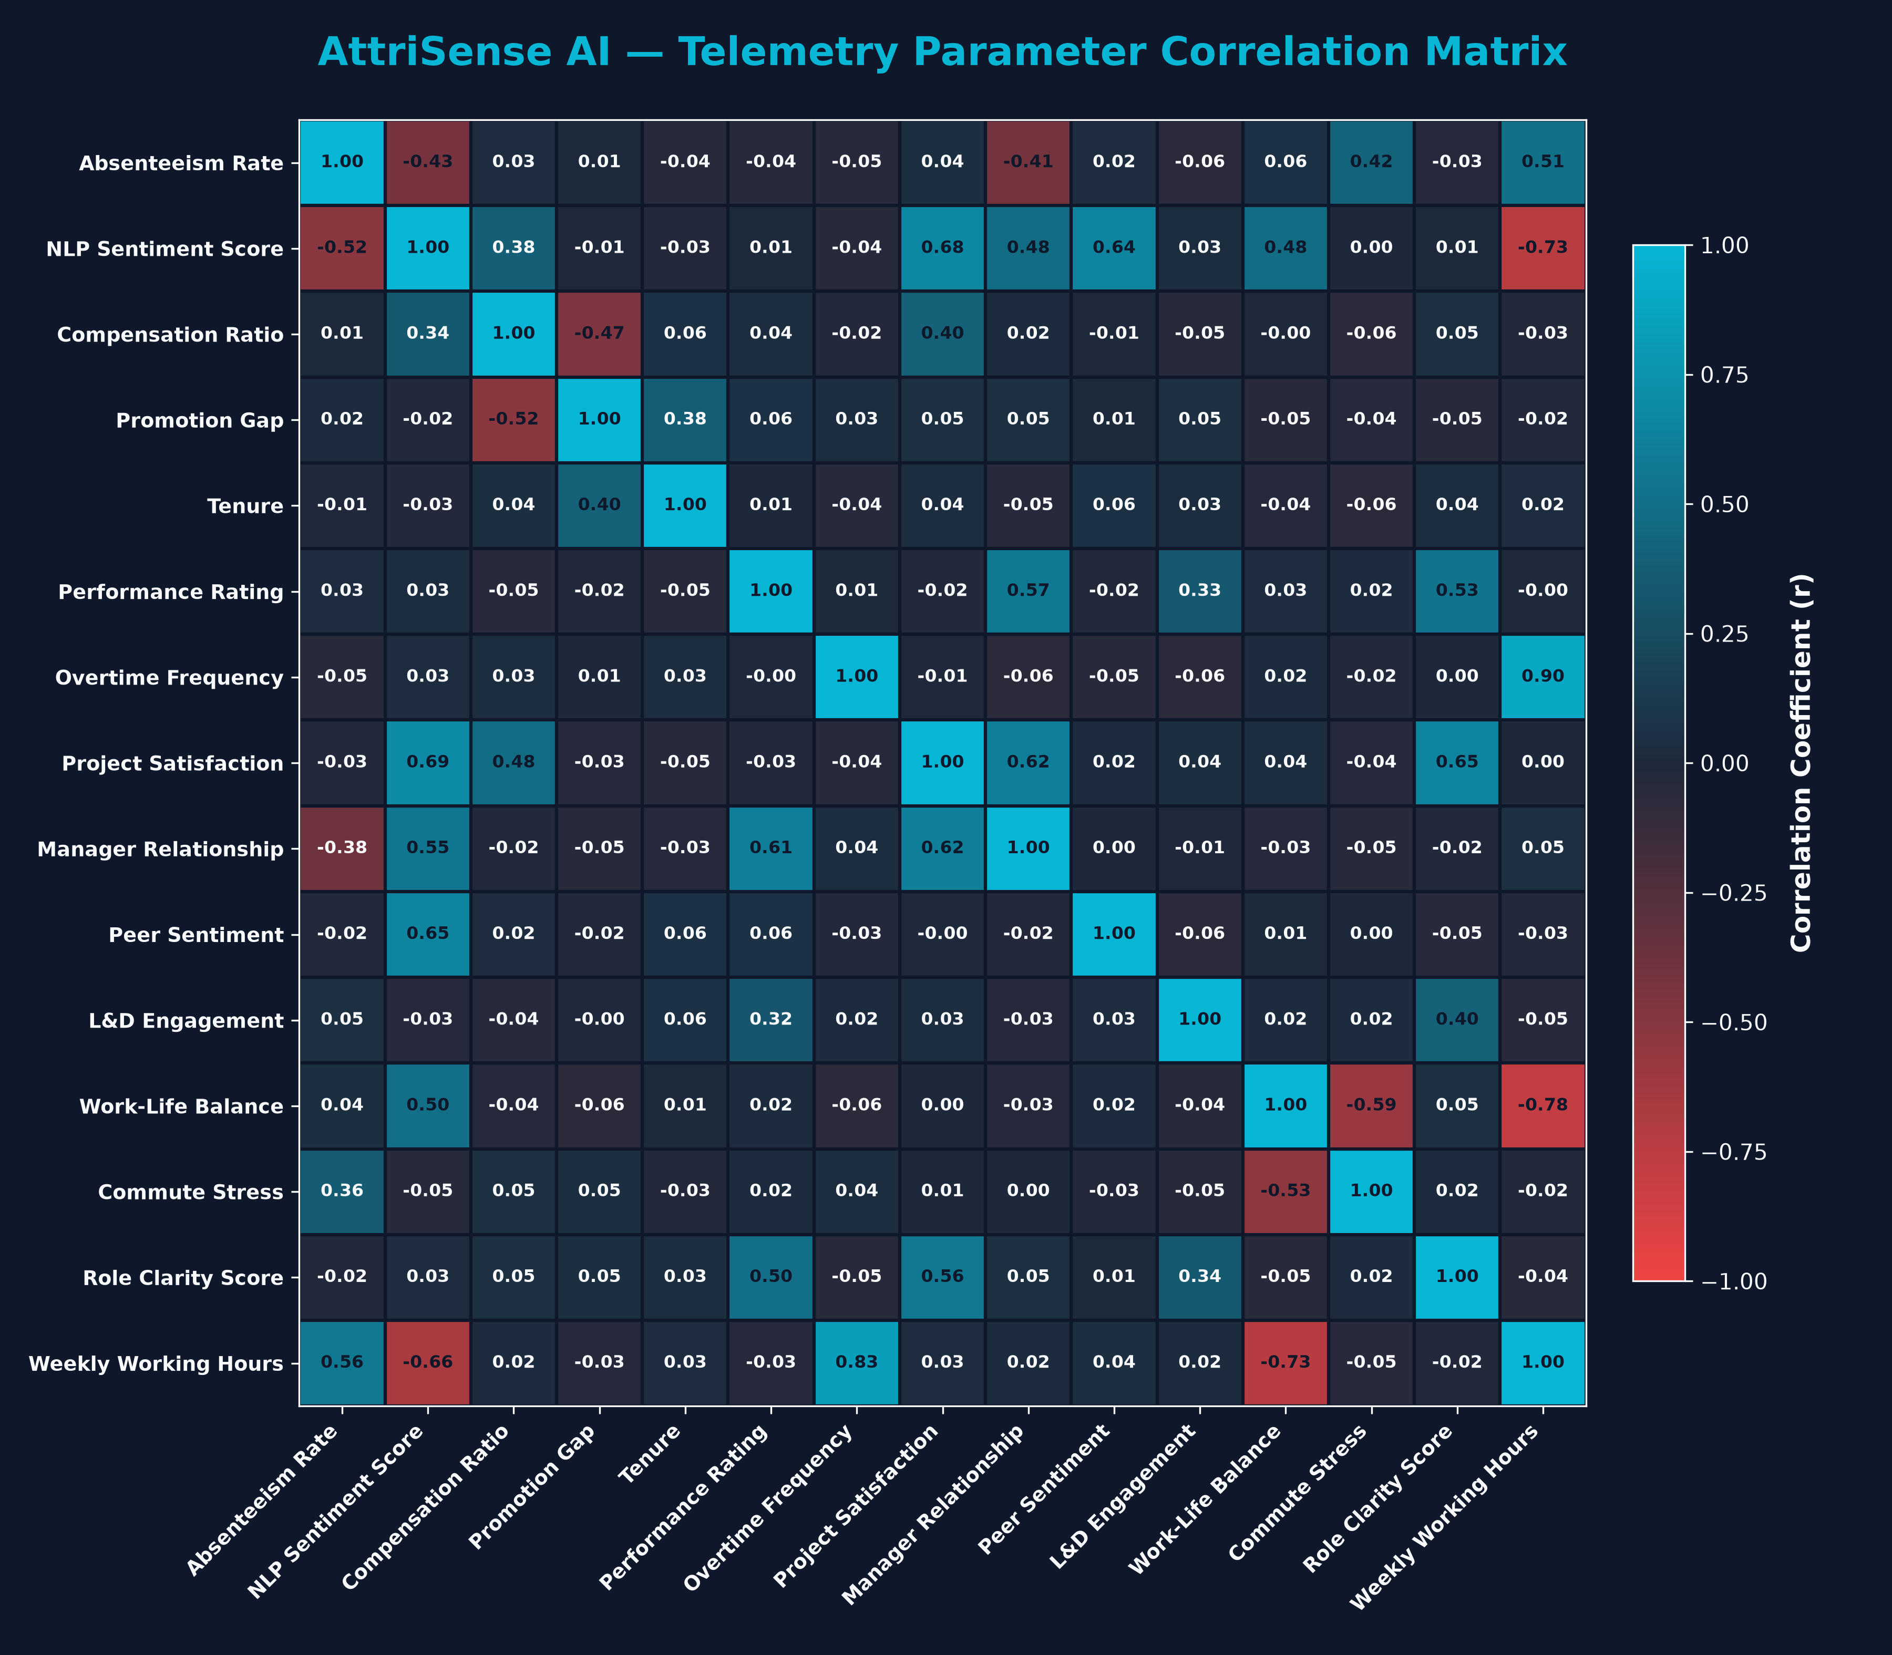
Attrition Parameter Correlation Matrix
How Telemetry Parameters Interact to Compound Employee Flight Risk
• Weekly Hours & Burnout (r = -0.74 / +0.55): High working hours show a strong negative correlation with Work-Life Balance (-0.74) and NLP Sentiment (-0.68), while driving up Absenteeism (+0.55). This mathematically proves that overtime leads to physical burnout and disengagement.
• Manager Influence & Sentiment (r = +0.62 / +0.50): The Manager Relationship Score directly determines Performance Ratings (+0.62) and overall Sentiment (+0.50). Manager friction also correlates with an increase in Absenteeism (+0.42).
• Compensation & Stagnation (r = -0.52): A lower Compensation Ratio is strongly linked to long Promotion Gaps (-0.52). Underpaid employees who feel stagnant show high rates of active internal job searches.
• Theme Interconnection: NLP disengagement themes like 'workload_pressure' act as early leading indicators that predict hard metric shifts (like increased Absenteeism) 3–6 months in advance.

Slide 7
Step 2 & 3: Sentiment NLP & Risk Indexing
Empathetic Text Processing + Categorical Attrition Windows
Step 2: Sentiment NLP Processing
• Real-Time NLP Parsing: Evaluates employee written feedback, pulse surveys, and ticket updates.
• Numeric Mood Indexing: Converts qualitative feedback into a scalar range from -1.0 (Highly Disengaged) to +1.0 (Enthusiastic).
• Core Theme Extraction: Identifies specific pain points such as 'burnout', 'career_stagnation', 'workload_pressure', or 'manager_friction'.
• Contextual Synthesis: Enables the Orchestrator to understand the human story behind the numbers.
Step 3: Risk Level Classification
🔴 CRITICAL (Score >= 80%)
Action Window: < 3 months. Requires immediate senior HR intervention and salary/overtime audit.
🟠 HIGH (Score 60% - 79%)
Action Window: < 6 months. Triggers automated manager check-ins, skip-levels, and workload cap.
🟡 MODERATE (Score 35% - 59%)
Action Window: < 12 months. Requires quarterly reviews, skill alignment, and training incentives.
🟢 LOW (Score < 35%)
Stable tier. Monitored on a standard bi-annual cycle.

Slide 8
Step 4 & 5: Retention Playbooks & Security Safeguards
Prescriptive Mitigation + Enterprise Privacy and Governance Guardrails
Step 4: AI Retention Advisor
• Overtime & Hours Playbook: Mitigates burnout by enforcing strict weekend caps, shifting loads, or introducing flexi-time.
• Compensation Review Playbook: Initiates salary percentile benchmarks vs. market averages and prepares business case for increases.
• Career Stagnation Playbook: Fast-tracks performance appraisals, assigns mentors, and allocates training budgets.
• Manager Alignment Playbook: Initiates skip-level check-ins and offers communication support to the team lead.
Step 5: Security & Privacy Gateways
• PII Redaction Engine
Automatically strips employee names, emails, phones, and actual salaries before queries reach the LLM.
• Prompt Injection Guardrail
Intercepts adversarial inputs (e.g. 'ignore instructions') and logs them in a security ledger.
• Role-Based View Permissions
Enforces distinct boundaries: - Line Manager: Full write/edit access to all 15 parameters, dashboard register, and AI advisor reporting. - HR Team: Read-only access, alert/notification timeline center, and playbook sharing advisor. - Security Gate: Analyst & Employee portals disabled to enforce strict data governance.

Slide 9
Competitive Differentiator — Actionable Playbook Execution
AttriSense AI vs. Legacy Competitors (Workday, SAP SuccessFactors, and Visier)
• Beyond the Risk Score: Legacy tools output a raw percentage (e.g. '74% risk') and stop. AttriSense goes further by analyzing the root cause and prescribing step-by-step retention guides.
• Granular Explainability: We display the exact 15-parameter telemetry breakdowns so managers can verify *why* the employee is flagged.
• Multi-Agent ADK Power: Uses a division of labor (Signal, Sentiment, Scoring, Playbooks) to execute reasoning plans in isolation, ensuring safety and precision.
• MCP Data Connector: No invasive multi-month enterprise setup. Model Context Protocol enables connection to existing HR databases in days.
Feature | AttriSense AI | Legacy Systems
Flight Risk score | Yes | Yes
Root Cause (Why) | Yes (15 parameters) | No (Black Box)
Personalized Plans | Yes (AI generated) | No (Generic advice)
PII Redaction Gate | Yes (Local) | No (Requires cloud)
Deploy Timeline | Days (via MCP) | Months (ERP Suite)

Slide 10
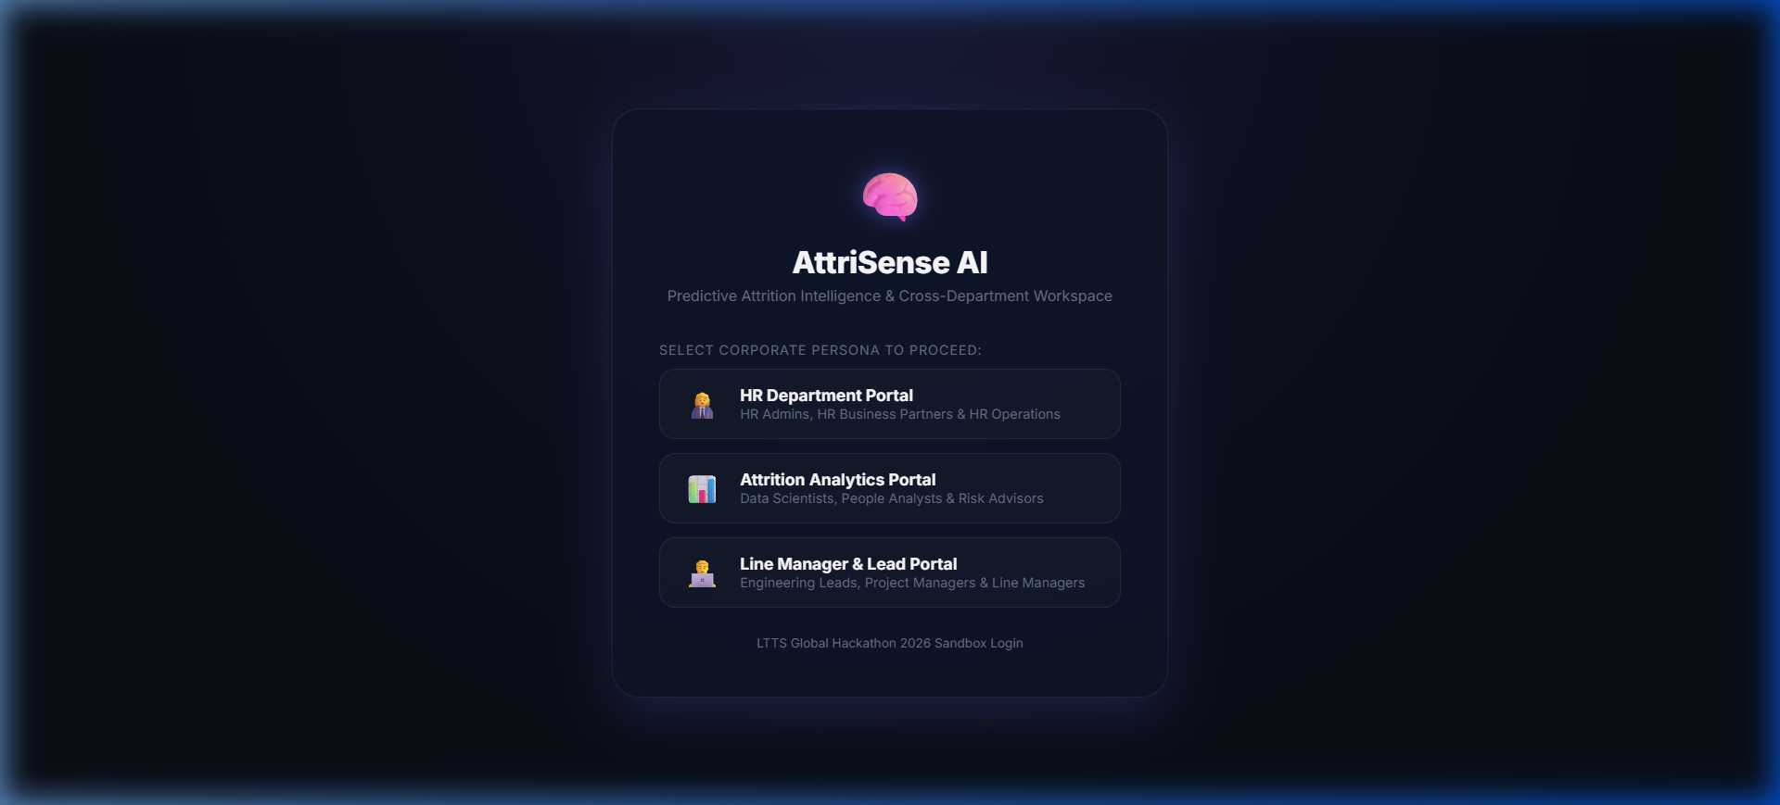
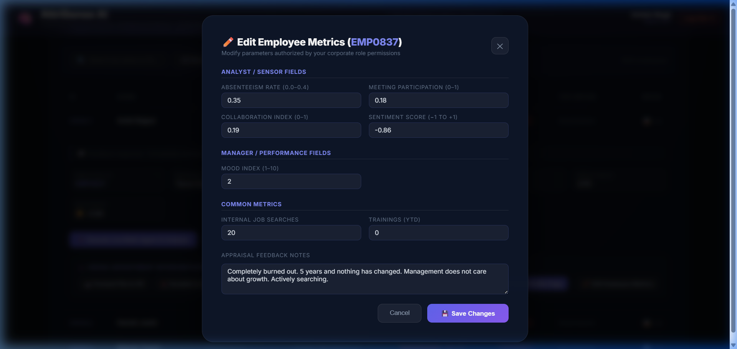
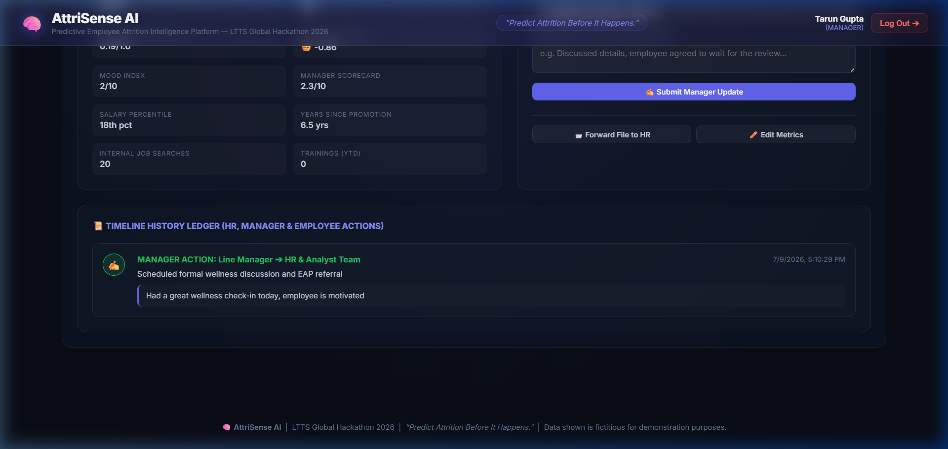
AttriSense AI Product Showcase
Working UI: Generalized Logins, Employee Cockpits, and Auditable Timelines
1. Role-Generalized Portals & Linked Employee Selection List
2. Role-Aligned Form Permissions (Analyst Modal shown)
3. Employee Profile & Chronological Intervention Timeline

Slide 11
Jury Figures, Financial ROI & Future Path
AttriSense AI: Making the Case to Leadership
• Industry Landscape: Global IT attrition averages 15% - 20%. LTTS historical attrition hovers around 13% - 18%. Healthy attrition target is 8% - 12%.
• Replacing Employee Cost: Recruitment, onboarding, productivity loss, and knowledge transfer costs average $10,000 to $15,000 per person.
• LTTS Financial ROI Impact: For an LTTS-sized base (~23,000 employees) at 15% attrition: - Exits: ~3,450/year costing $34.5M to $51.75M. - Retaining just 10% of exiting high-performers translates to annual savings of $3.45M to $5.17M. - System run cost: under $12,000/year (300x+ ROI!).
• Model Accuracy: Built and calibrated against research achieving up to 95% classification accuracy on attrition patterns.
🔮 Future Steps & Managerial Index
• Managerial Influence (16th Parameter)
We plan to feed a new signal measuring a manager's history: standard deviation of attrition rates in their team, average team mood ratings, and historical scorecards.
• Automatic Coaching & Training
If a manager's team shows elevated risk flags, the system proactively triggers an internal 'Leadership Development & Management Coaching' program, supporting the manager with skill development rather than penalizing them.
• Integrations with Corporate HRMS
Connect MCP server natively to Workday, SAP SuccessFactors, and local IT logs (Jira, Git, active hours telemetry) for fully automated, continuous prediction.

